Slide 1
KwickLine
Team 11
Notes:
We are team 11

Slide 2
Content
1
Overview
What is KwickLine
2
Our Design
CAD rendering
Prototype
Using KwickLine
3
Features
Variable length
Easy replacement
Magnetic connection
Challenges
4
Business Proposal
Market research
Competitors
Price
Notes:
Chloe Brief overview of what we will talk about
What our product is, our design, features, and business proposal

Slide 3
Overview
Notes:
20

Slide 4
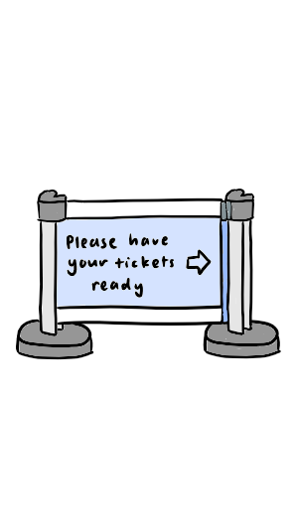

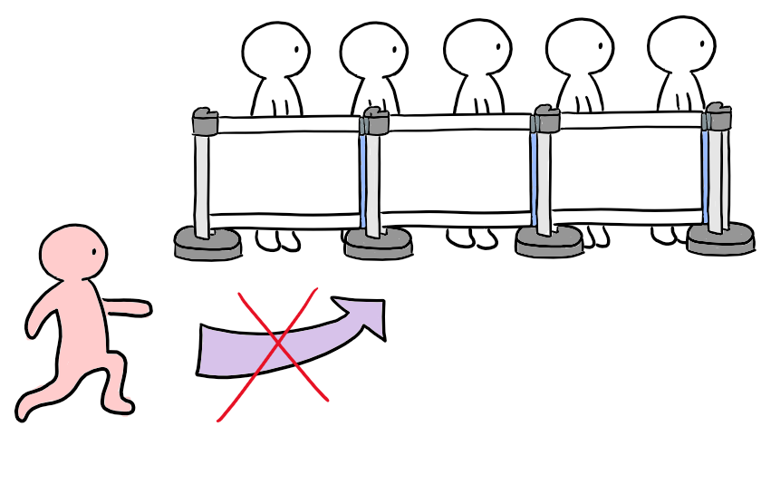
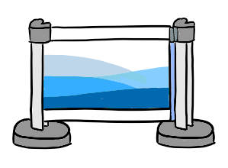
What is KwickLine
✘ Queue jumping
✔ Customizable
Notes:
Maxwell
It is a queue barrier, prevents people from queue jumping and directs the crowd
Can be used at airports, museums, theme parks or anywhere that requires crowd management
This prevents people from leaving or entering the queue below the barriers -> Prevents queue jumping
Customizable(highlight): U can put anything such as ads, art or instructions
Convenient to swap the content inside using our design

Slide 5
Our Design
Notes:
60

Slide 6
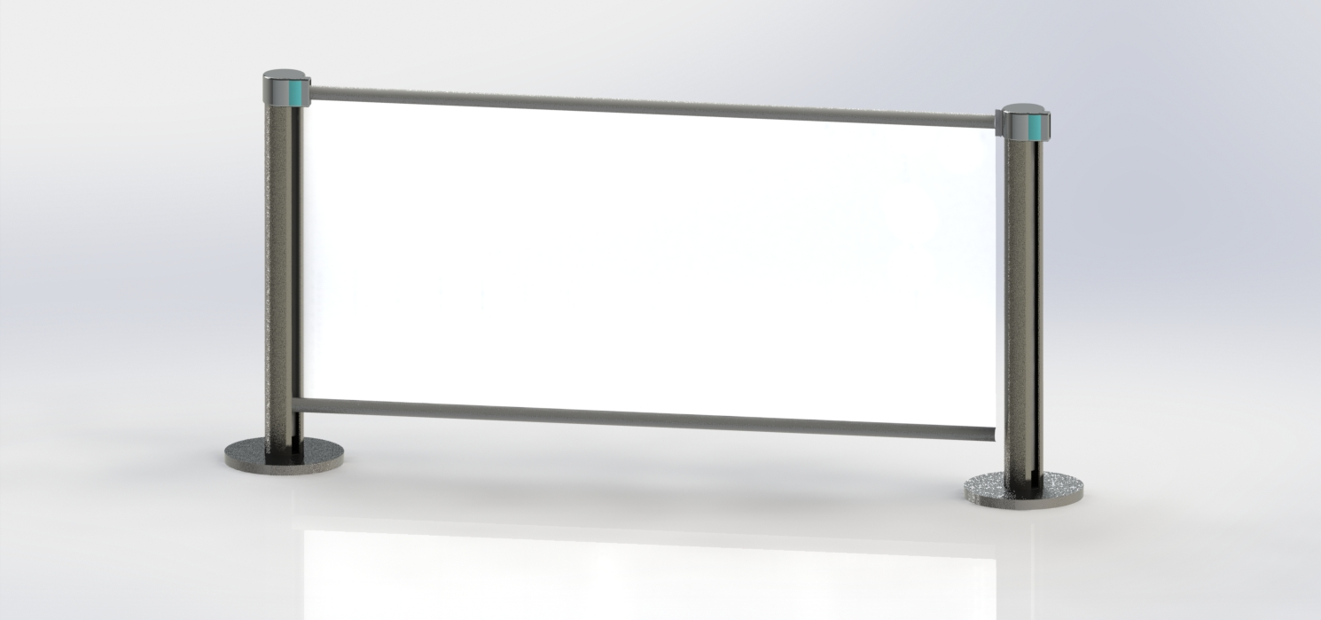
CAD Rendering
Notes:
Yam
CAD rendering of the basic configuration 2 columns and the extendible sheet (transparent plastic banner)
Point where the c-tubes are

Slide 7
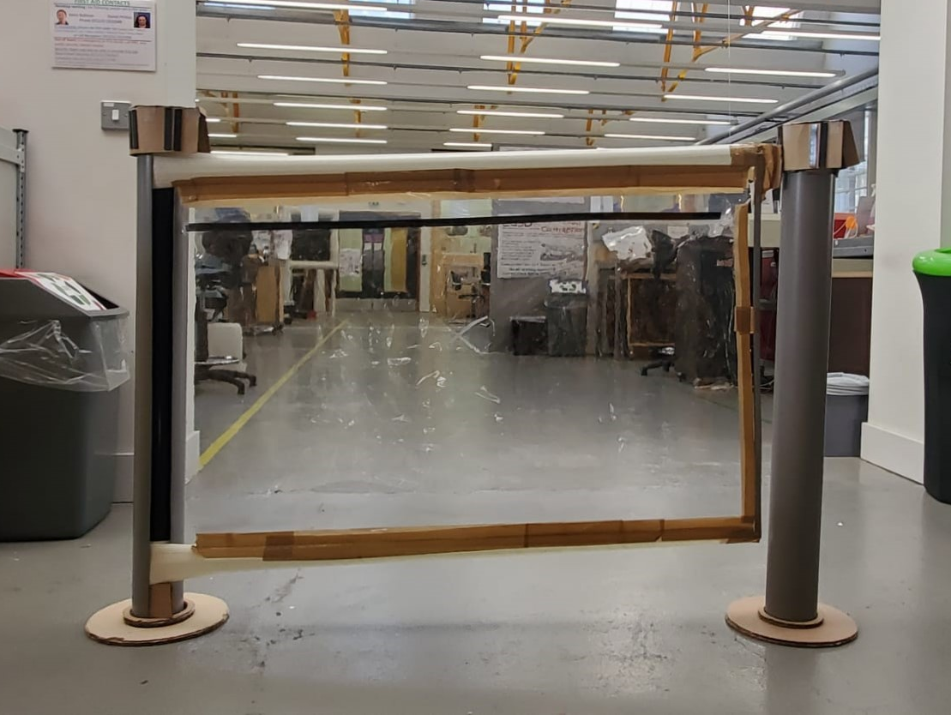
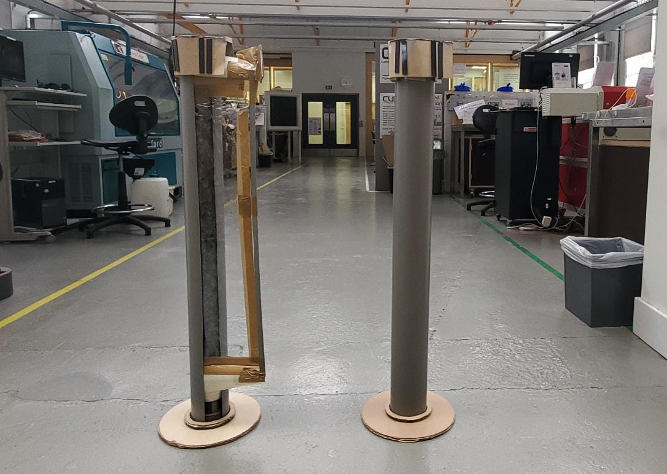
Prototype
Notes:
Chloe
Open/closed state with closed

Slide 8
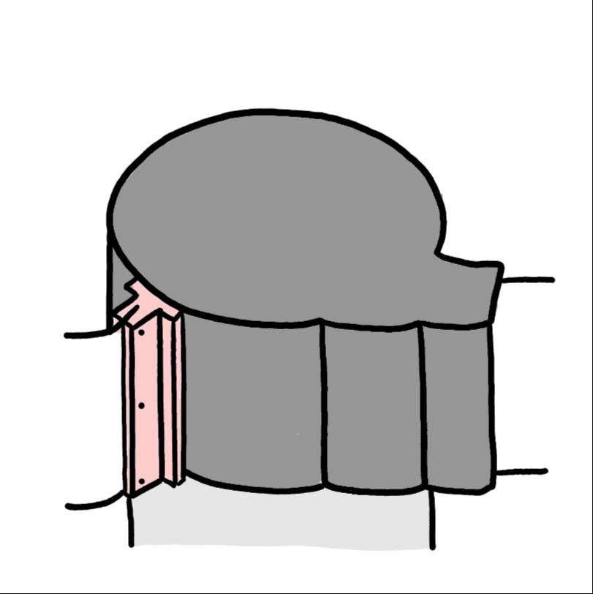
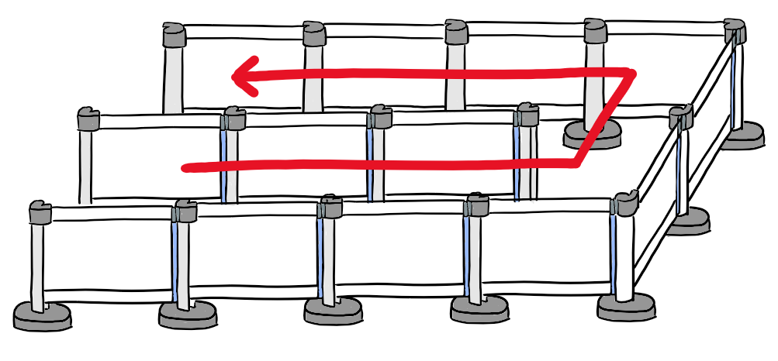
Using KwickLine
Notes:
Benson
Kwickline has a modular design and using the basic building block of two columns and a screen, we can connect as many kwicklines as we want to make a formation like the one above
The screen is connected to the column in 3 different configurations as shown in the gif so kwickline can be connected in a straight line or at 90 degree angles
Note that the screen is always connected to two columns, so it would not act like a flag and move about freely in the wind for outdoor applications

Slide 9
Features
Notes:
2:05
Thomas
So now we will talk about the features of Kwickline

Slide 10
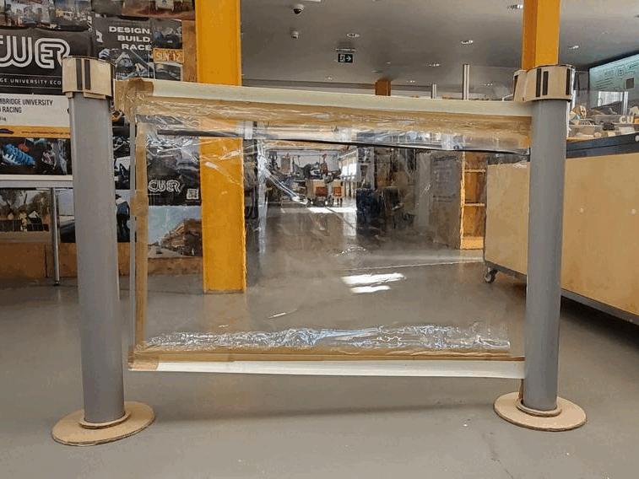
Variable length
Notes:
Thomas
Kwickline can be adjusted into different lengths
More flexibility for the end user, allow different banner sizes
Talk about normal queue barriers with ads have a fixed length → we are better than them

Slide 11
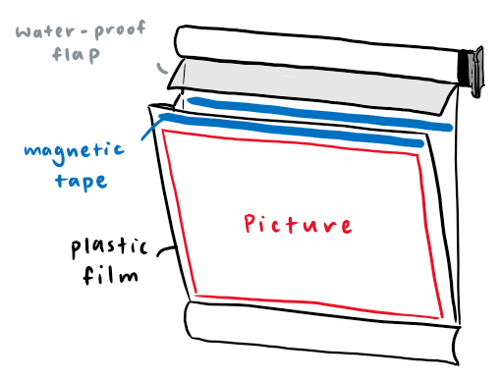
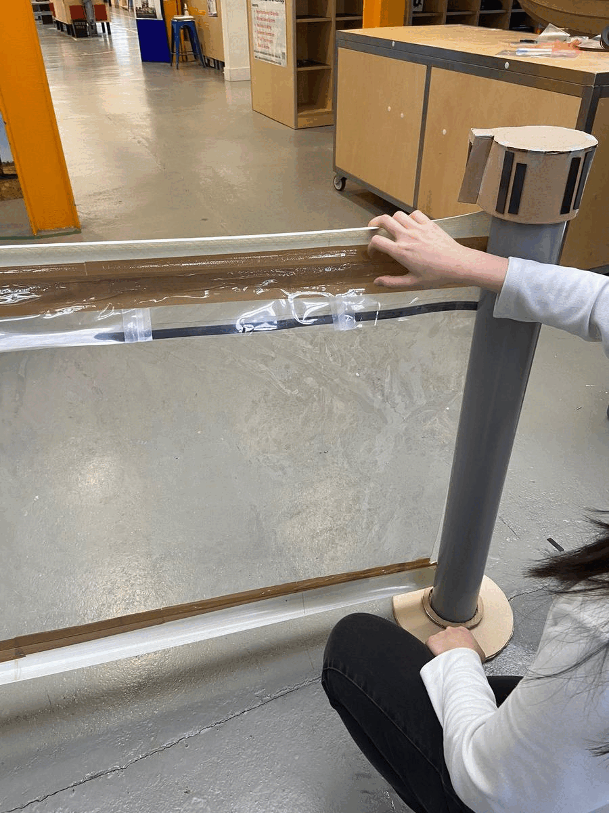
Easy replacement
Notes:
Benson
Another feature of kwickline is that the contents in the screen can be replaced very easily as the screen is held by two pieces of magnetic tape
To replace the contents, we simply open the front screen, take out the old content, put in the new content and close the front screen
Moreover, there is a waterproof flap on top to prevent any water or snow from getting into the screen in any outdoor applications

Slide 12
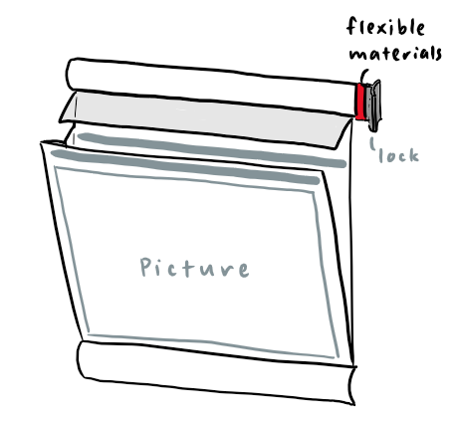
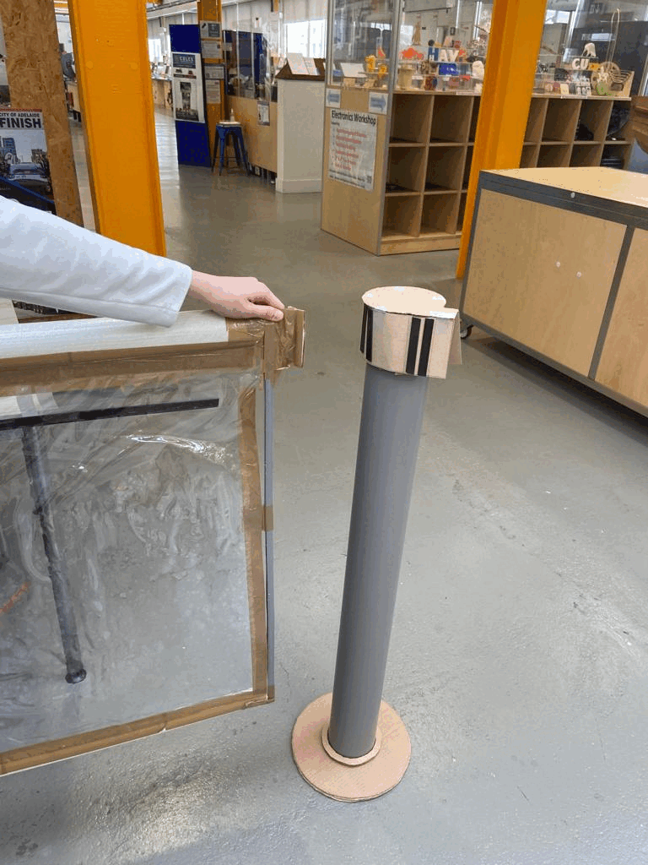
Easy connection
Notes:
Chloe
Satisfying “snap on” magnetic connection that ensures a sturdy connection between barriers
Resists wind
Snap on from different angles → Allows different configurations
Future:
Can incorporate both magnetic and mechanical connections (top and bottom) to make is stronger

Slide 13
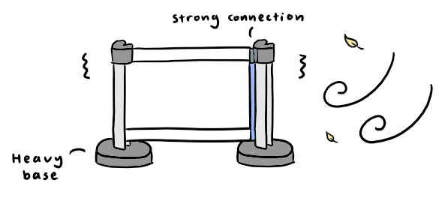
Challenge - Wind
Notes:
Thomas
Heavier base → more stable and less likely to topple over
Stronger connection between the screen and the column (perhaps mechanical instead of magnetic), harder to fall off under strong wind

Slide 14
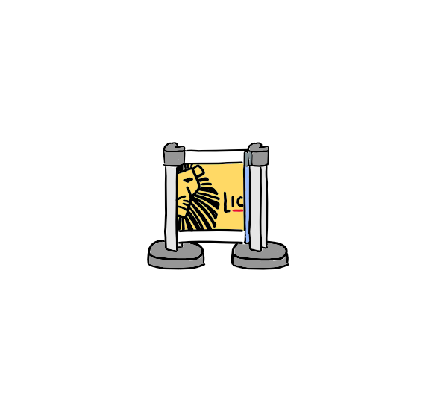
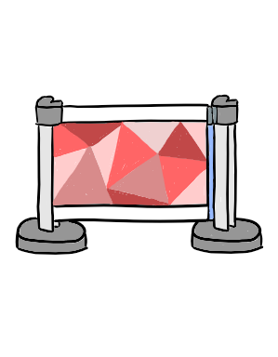
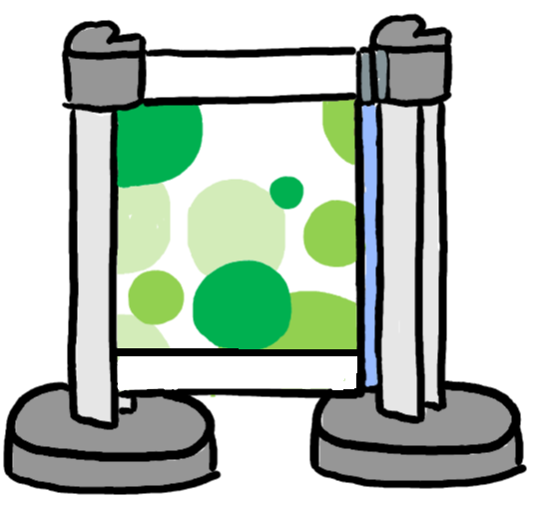
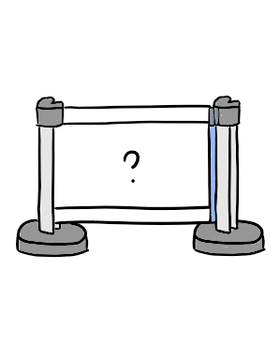
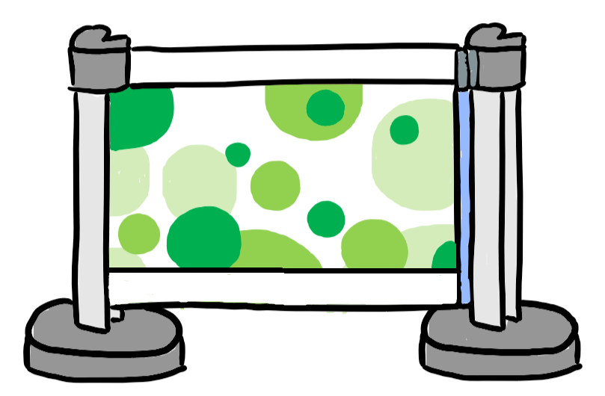
Challenge - Aesthetics
Notes:
Benson
Another concern that might come up is the aesthetics, ie the general appearance of Kwickline
What if Kwickline is unrolled half way? What if the client just wants a generic barrier and doesn’t know what to put in the screen?
The solution to this is to provide a few generic patterns for the user that come along with the product
As you can see these patterns look decent even when unrolled half way

Slide 15
Business proposal

Slide 16
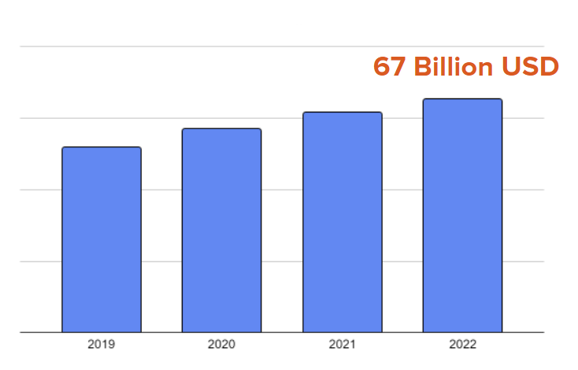
Market research
Outdoor Printed Ads Market Size
Potential Customers (UK)
Malls
Airports
Hospitals
Museums
Total: > 4000 venues
Notes:
Maxwell
Demand / potential customers
Numerous public facilities that need crowd management systems like malls, airports hospitals and museum, etc. The number of these facilities will be growing in the future as well
Market size of ads(one of the major functions of our product)
We can tap into the outdoor printed ads market as well
The global outdoor printed ads market is expected to grow from $61 billion in 2021 to $67 billion in 2022
We believe that this is a viable business

Slide 17
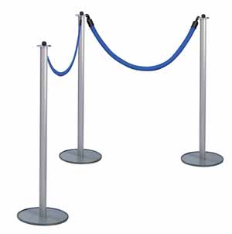
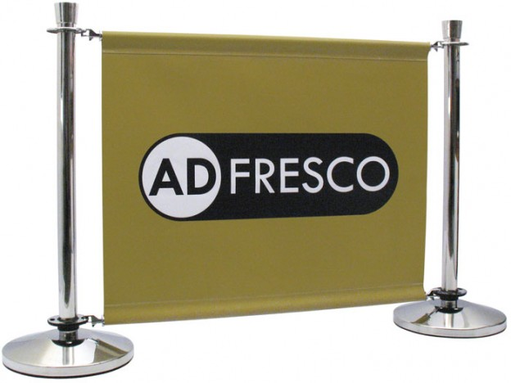
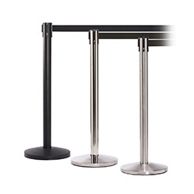
Competitors
Post & rope barrier
Cafe barrier
Retractable belt barrier
Notes:
Benson
As for the existing competitors, they either cannot display anything (ads, instructions, art), are of fixed length or cannot be compact (since the screen cannot be rolled up into the column)
Yes kwickline does not have these problems, but why would users that already have many queue barriers invest in kwickline?
Kwickline will mainly appeal to customers who need to replace the contents of the screens frequently as it is quite costly in terms of money and time to replace the contents in traditional barriers

Slide 18
Prices
£159
< 5 units
£139
> 5 units
£15
Rental
Notes:
Maxwell
Production cost:
60 pounds per unit
Selling price:
159 pounds for purchases less than 5 units (for smaller shops such as cafe, matches the price of other queue barriers with custom banners)
139 pounds for purchases over 5 units (for shopping malls, airports, etc, bulk purchases)
Rental:
Alternative business model is rental or for hire
15 pounds per unit per day
Suitable for large events such as exhibitions, concerts, trade shows, etc

Slide 19
Q&A

